Slide 1
Ode to V1943 Sagittarii
How it foiled our Station 3 Josephina observation on 2020 July 10

Slide 2
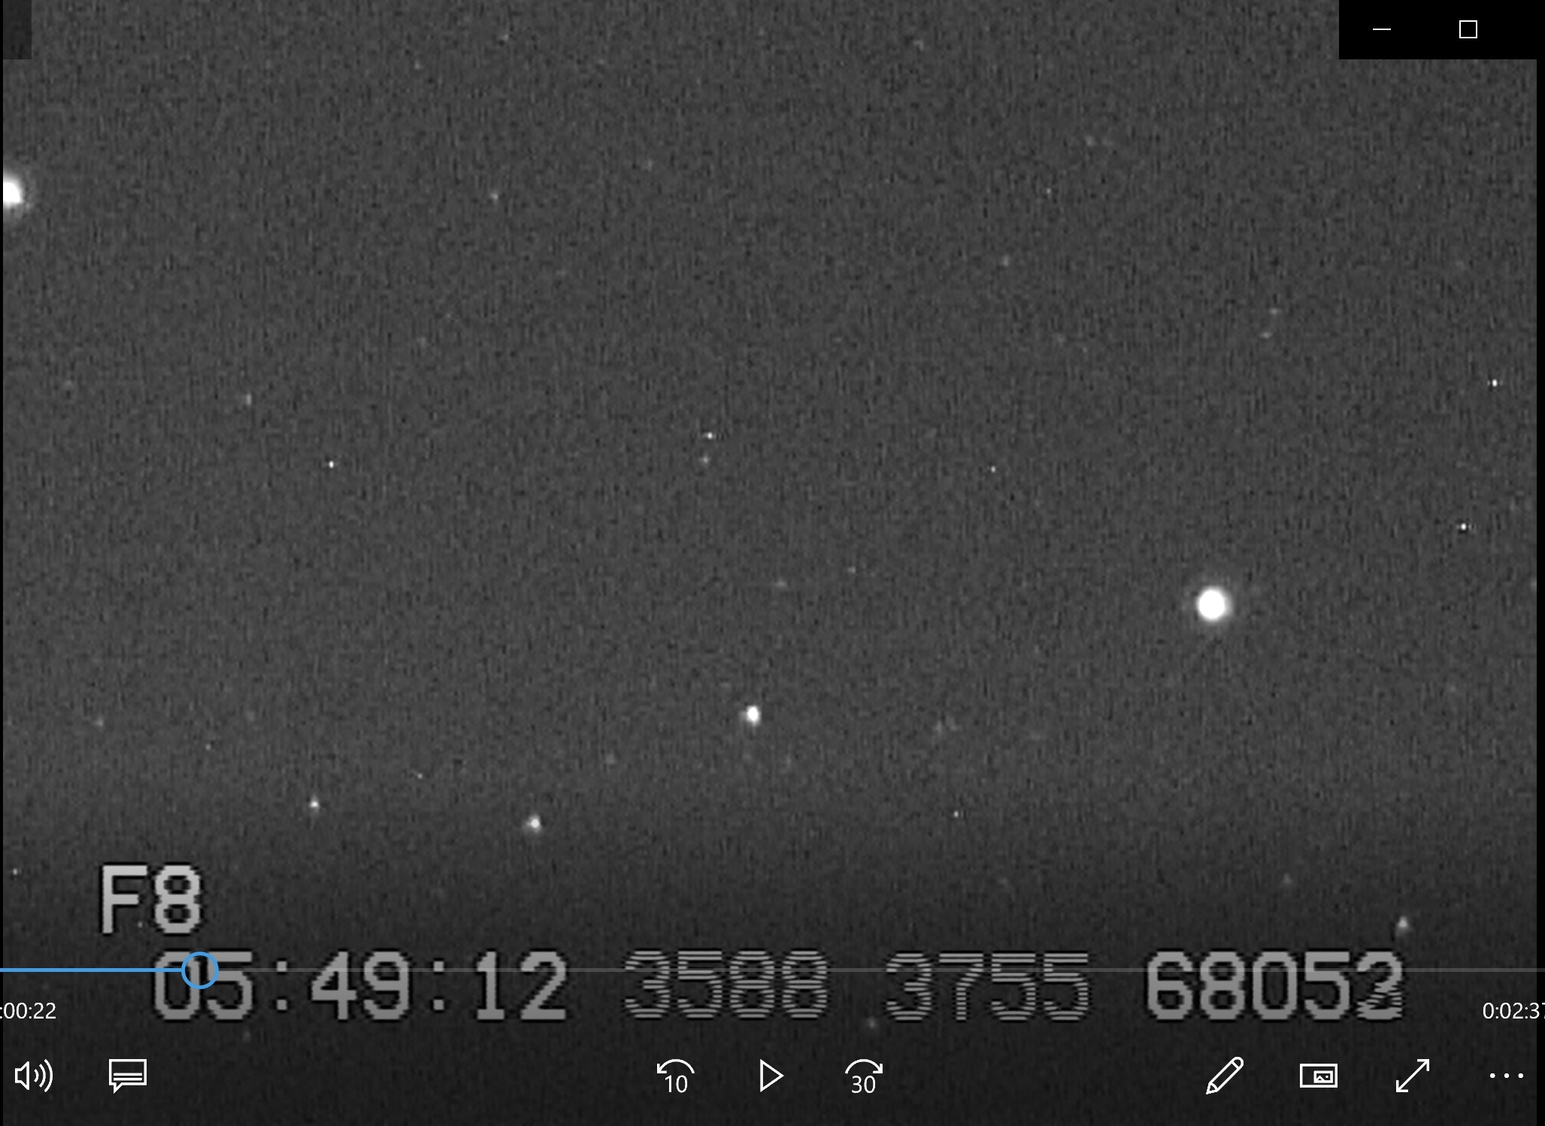
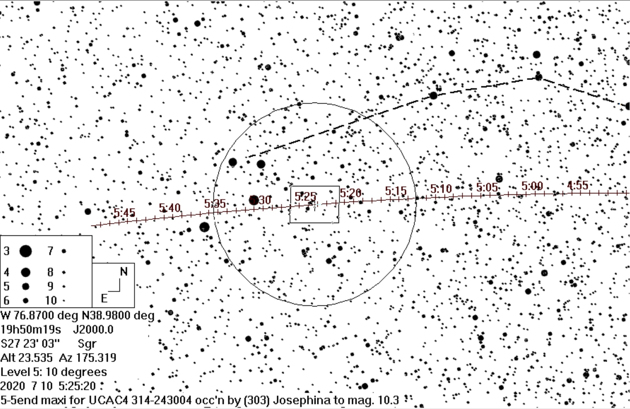
The pre-point chart showing the Terebellum asterism
Using a laser pointer, David was pretty sure
that he was at or near Terebellum,
about 7° below Saturn
From video recorded with the
12cm “maxi” system
60
Terebellum
ω
62
59
But the pattern of stars around the
bright star at the left edge and the
one on the right side, didn’t match
any of the pairs of Terebellum stars,
and only a minute to the occultation.
SAGITTARIUS

Slide 3
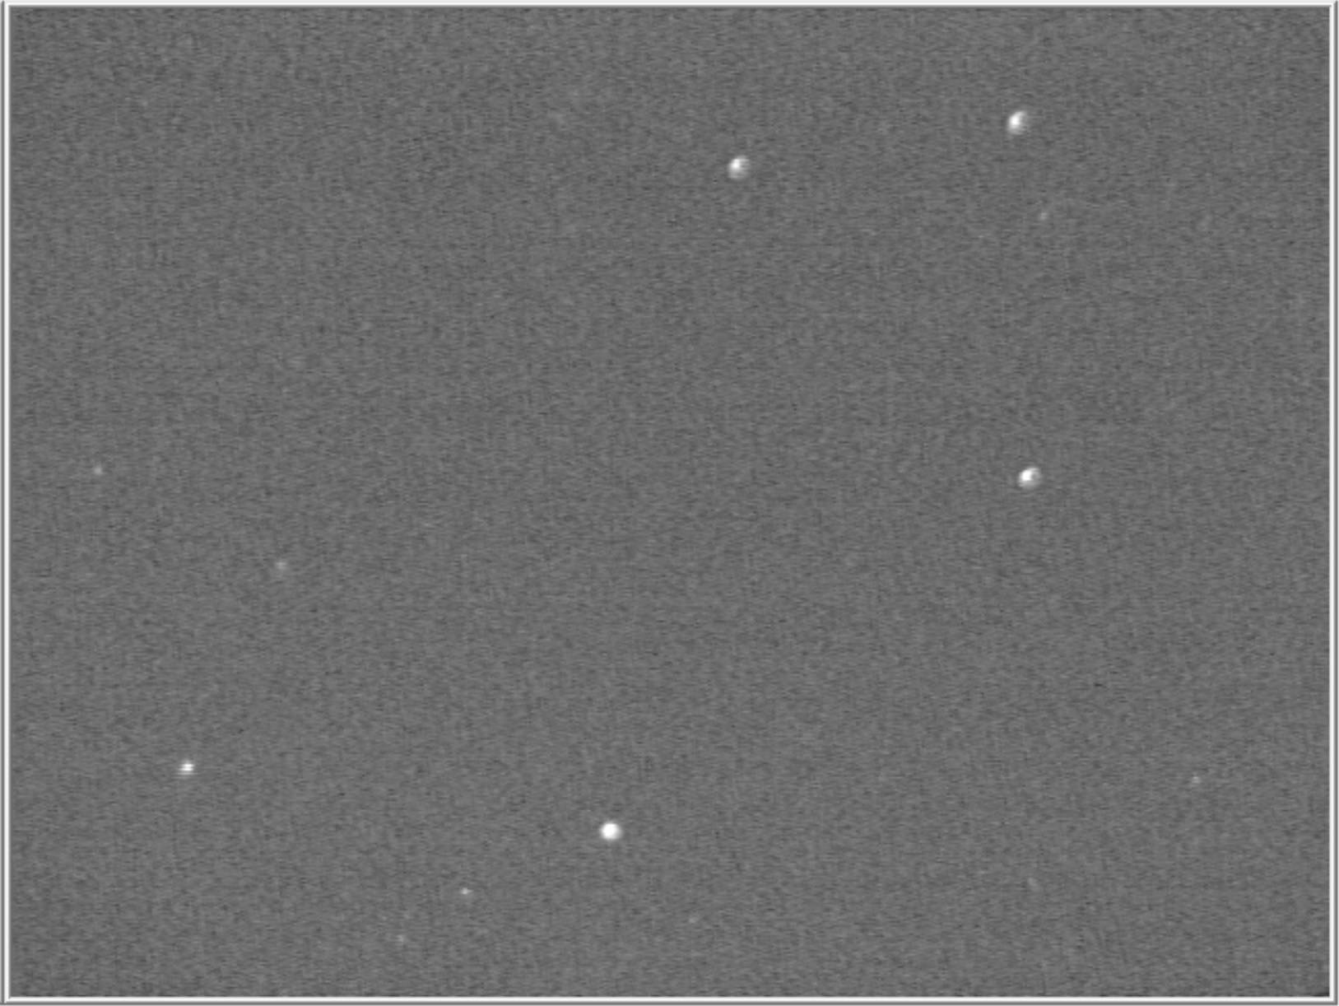
Terebellum image with a mighty mini 2 nights later
The mystery is solved. With our
red-sensitive Runcam camera,
there is a 5th bright star in the field,
not just the 4 stars with Flamsteed
numbers & Greek letters that are
all about 4 ½ mag. The other star,
appearing at about 5 ½ mag., is the
red (spectral type M8) star
V1943 Sagittarii, plotted as an
indistinct 7.7-mag. star on the
Guide chart I used. The two stars in
my maxi video view shown on the
previous slide were V1943 and 62. I couldn’t see them well enough with my visual
finder, but I would have quickly figured it out if I had used our mighty mini finder.
.
ω
60
59
V1943
62

Slide 4
The pre-point chart showing the Terebellum asterism
V1943 is marked, plotted as 8th mag. but appear-
ing as about 5 ½ mag. in my maxi FOV, shown
below.
From video recorded with the
12cm “maxi” system
60
Terebellum
V1943
ω
62
59
The small rectangle on the left side of the chart to the right enclosing V1943 & 62 Sagittarii shows the
FOV of the image from the “maxi” video above while the large rectangle shows the mighty mini FOV shown in the previous slide. The 5° diameter
circle at the center
SAGITTARIUS

Slide 5
A way to identify very red stars on our charts
With Guide8/9, you can click on the star to find out its spectral type & variable name (if any), but doing that for many stars is too tedious.
But with Guide8/9, you can show the star colors, and find the red ones that are sensitive to our cameras. However, there are a lot of orange (spectral type K) stars, and it’s hard to distinguish them from the red (spectral type M) stars; it’s mainly M5 and later stars that affect us.
Another way with Guide8/9 is to show variable stars; that’s probably the most efficient way to find these stars, but we only care about the very red ones, the Mira and semi-regular red variables; eclipsing variables are rarely a problem.
I show in the following slides some examples of different variables in the Terebellum field, noting things to look out for.
For future use, I plan to use my video finder (so much better & easier than the visual one) and have my laptop with Guide8 & the pre-point line with me, so I can check out anything suspicious noticed in the video finder or scope FOV.
I use Guide8/9, not C2A, which probably has similar capabilities.

Slide 6
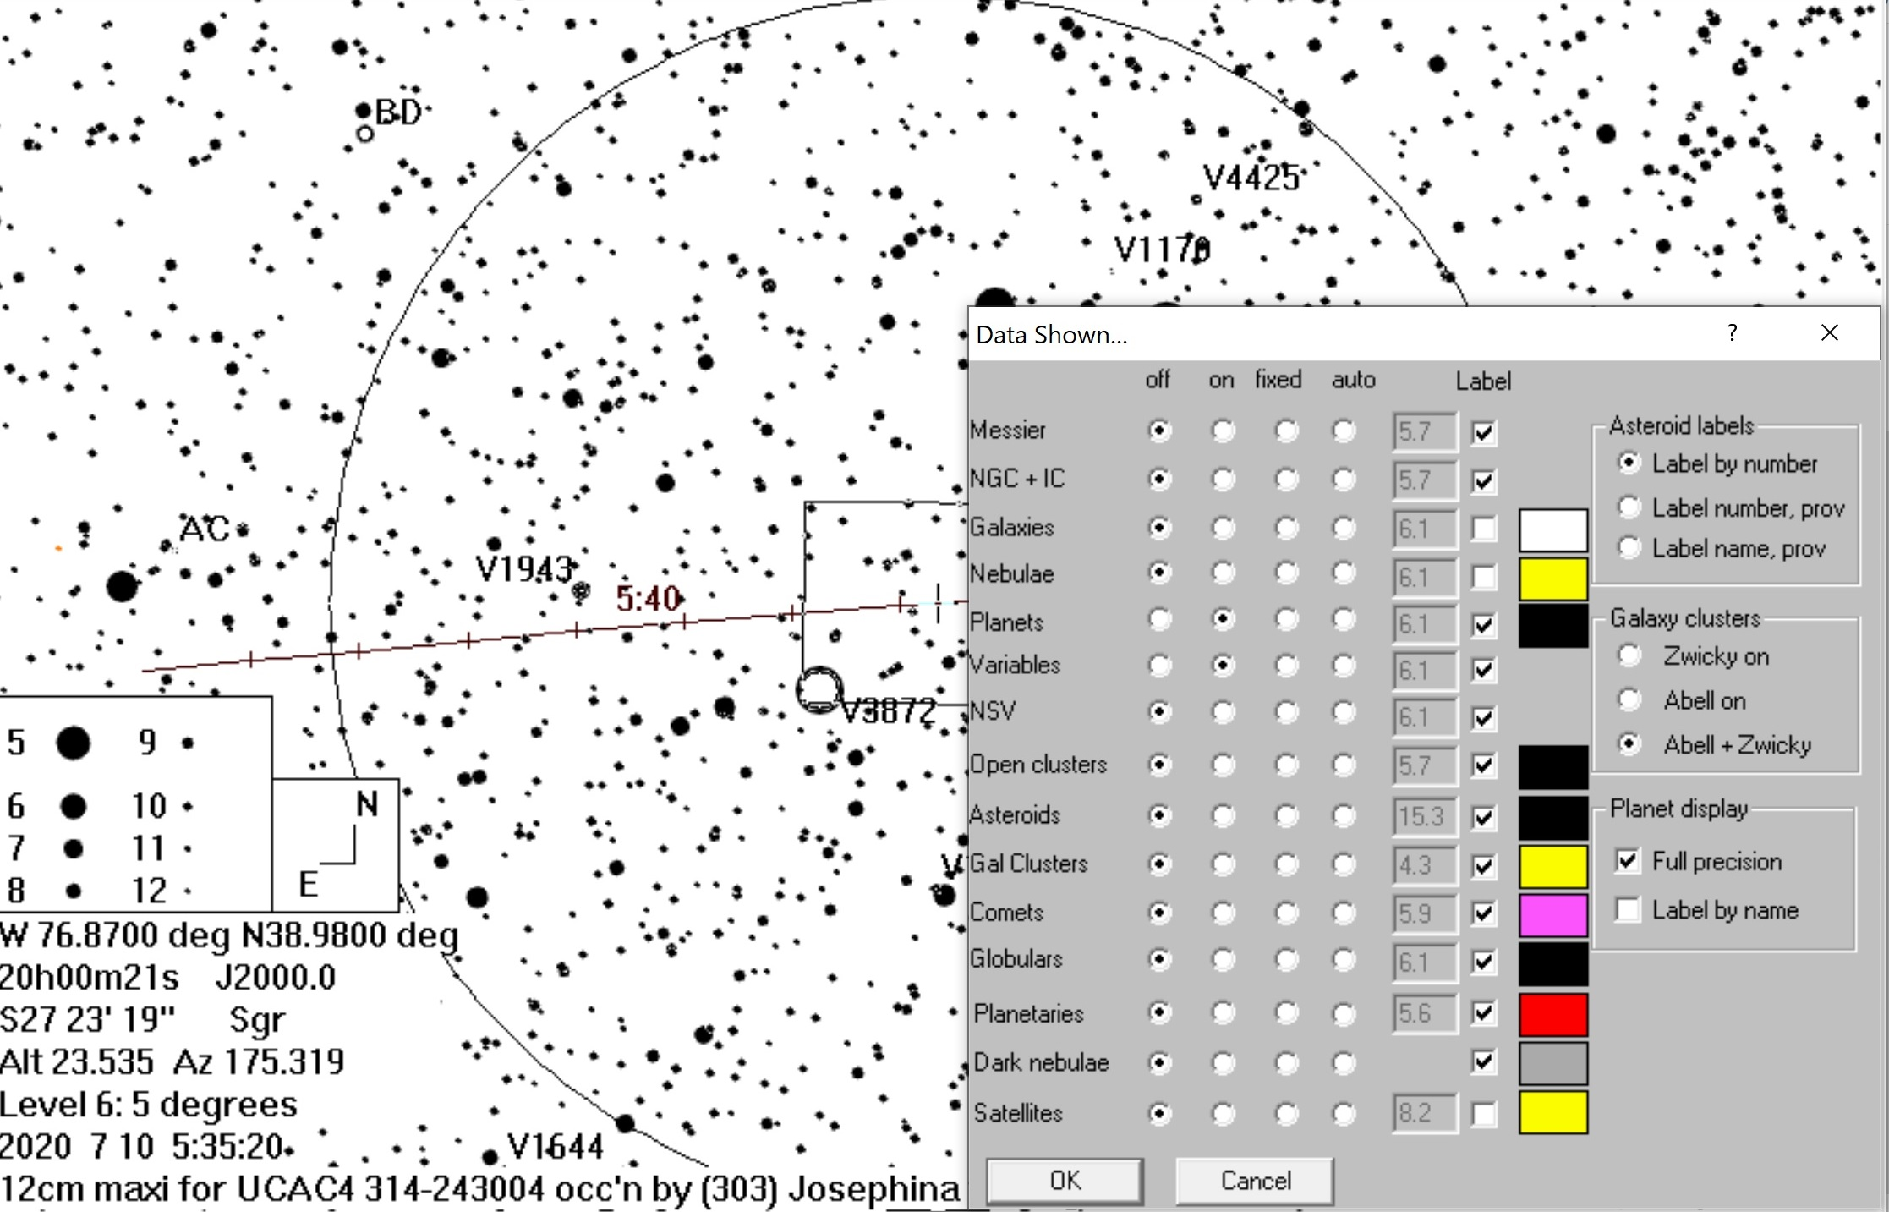
Terebellum field showing variables
Normally, I turn all off except planets on the
“Data Shown” tab, but here, I turn on the
Variables as well.
________
62

Slide 7
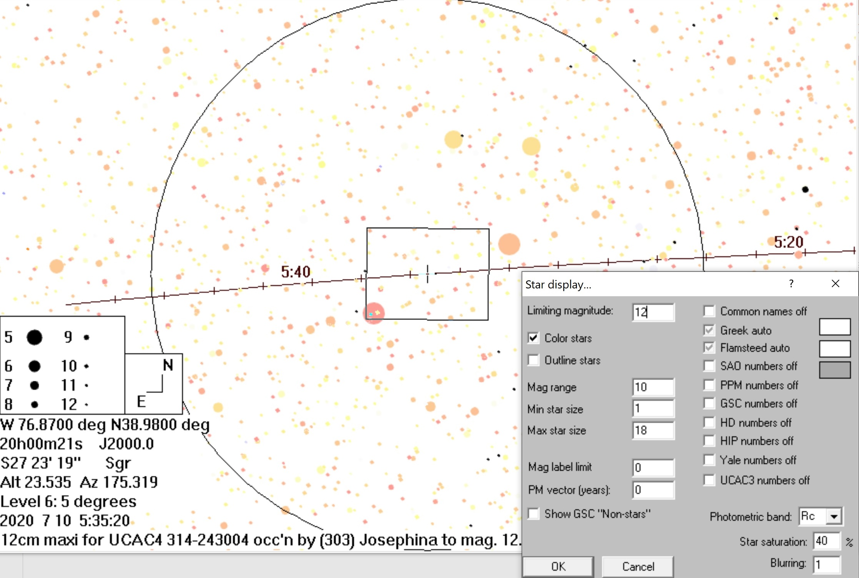
Terebellum field showing star colors
Select “Color stars” on the Star Display to find
find red spectral type M stars (2 are marked),
but they are hard to distinguish from orange,
& charts with “Color stars” off are easier to
read when used at the telescope.
59
→
62
←
_____

Slide 8
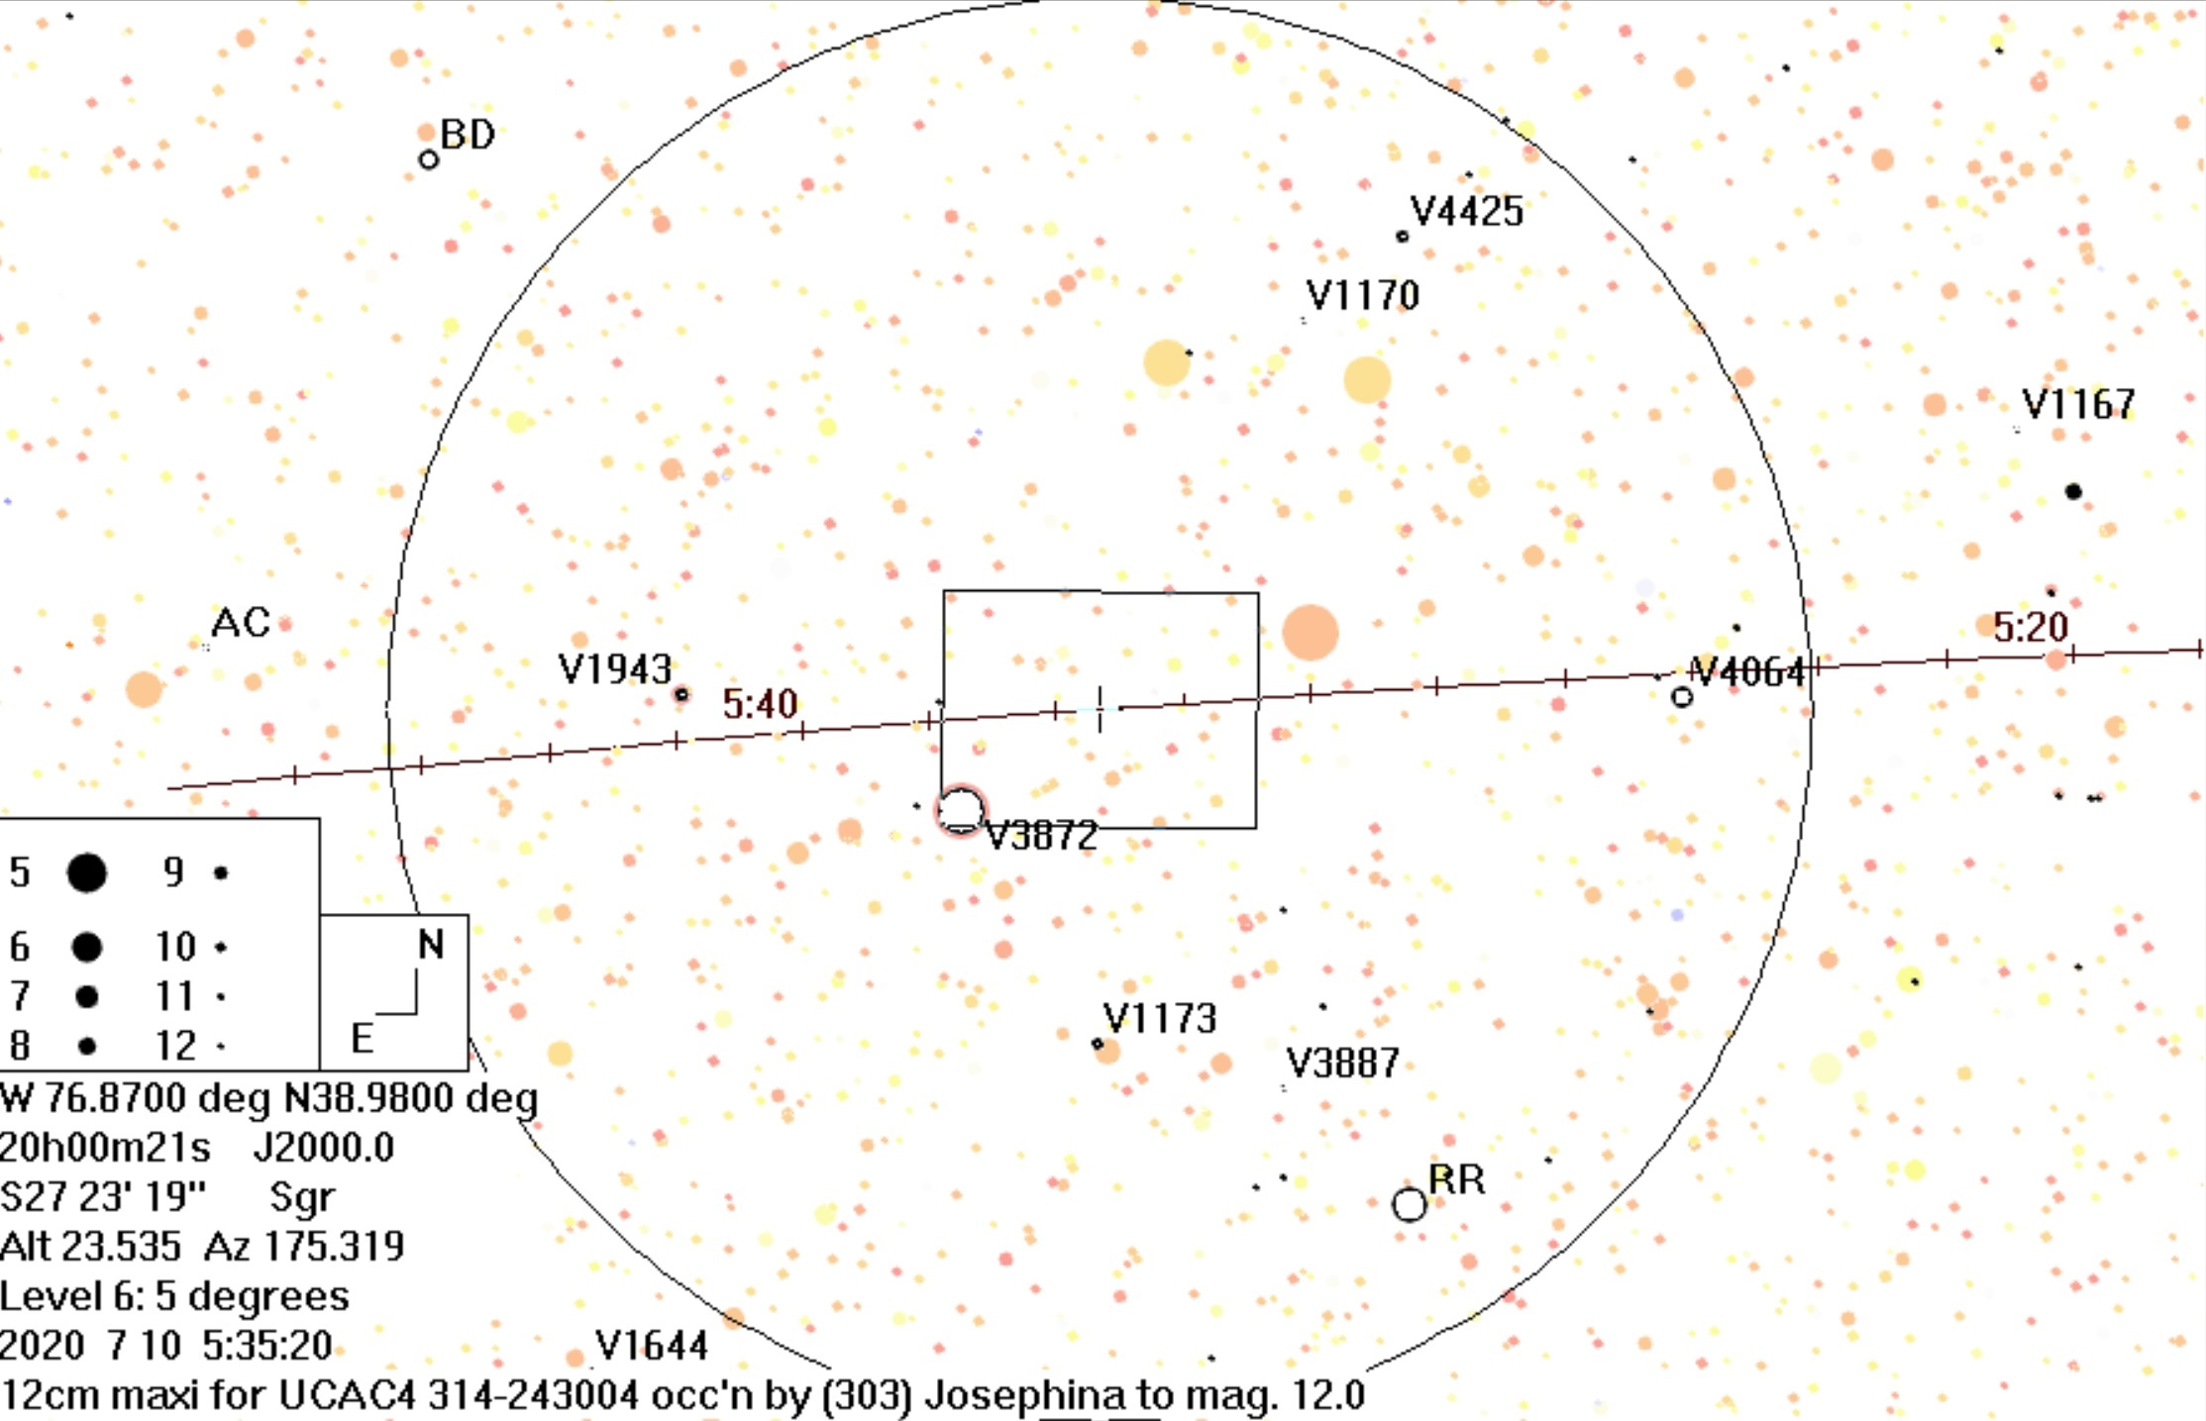
Terebellum field showing star colors and variables
Variables are sometimes
shown as open circles
with size at maximum
Stars discussed
in this and the
following
slides are
underlined
60
ω
__
59
___
62
V3872 = 62 Sgr, mag. 4.4,
spectral type M4III,
“unsolved variable”
with range only 0.05 mag.
____
___
___
__

Slide 9
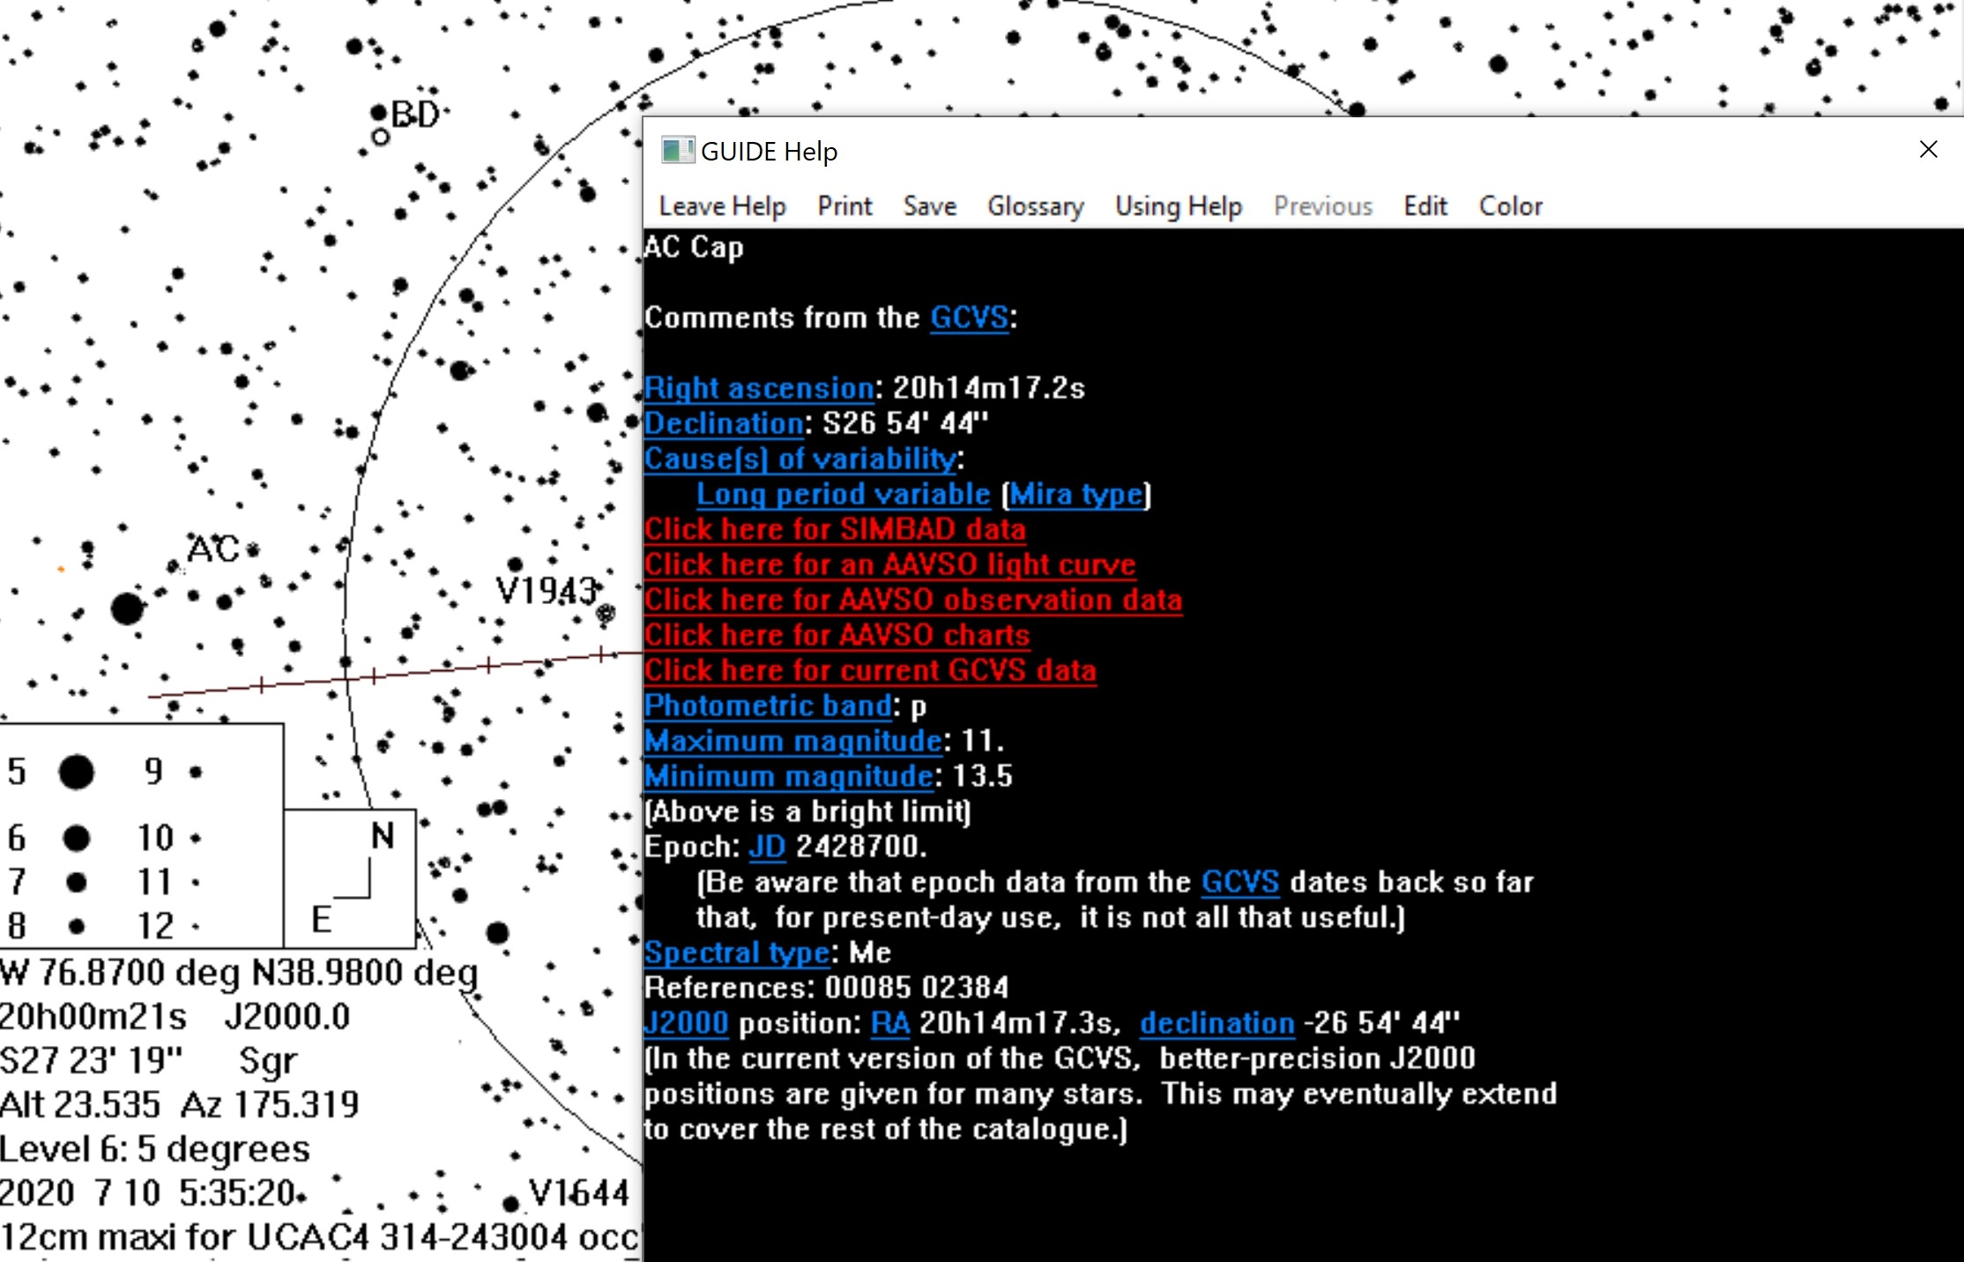
AC Capricorni
The basic info. box says it’s a
long period Mira variable
__
Clicking on the AAVSO lines
here gives broken links
Relatively faint red star without
a large mag. range so not a concern
← Late spectral type (red, brighter for us)
The target star is only ½ deg. south of this star.

Slide 10
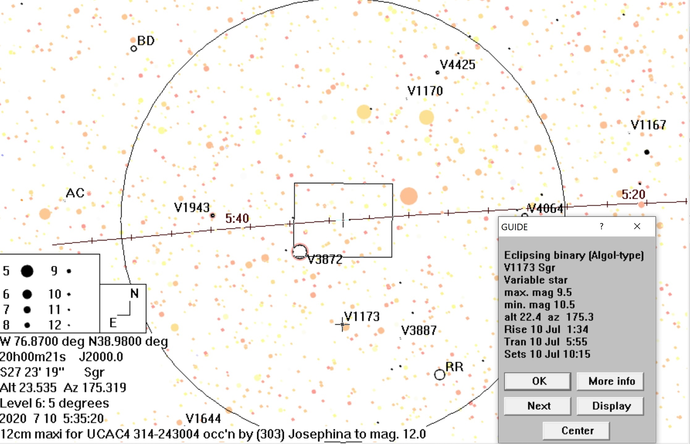
V1173 Sagittarii
Right clicking on the star gives
the basic info. box below which shows that it’s an eclipsing variable with a mag. range of only 1.0 so it’s not a concern for us.
___

Slide 11
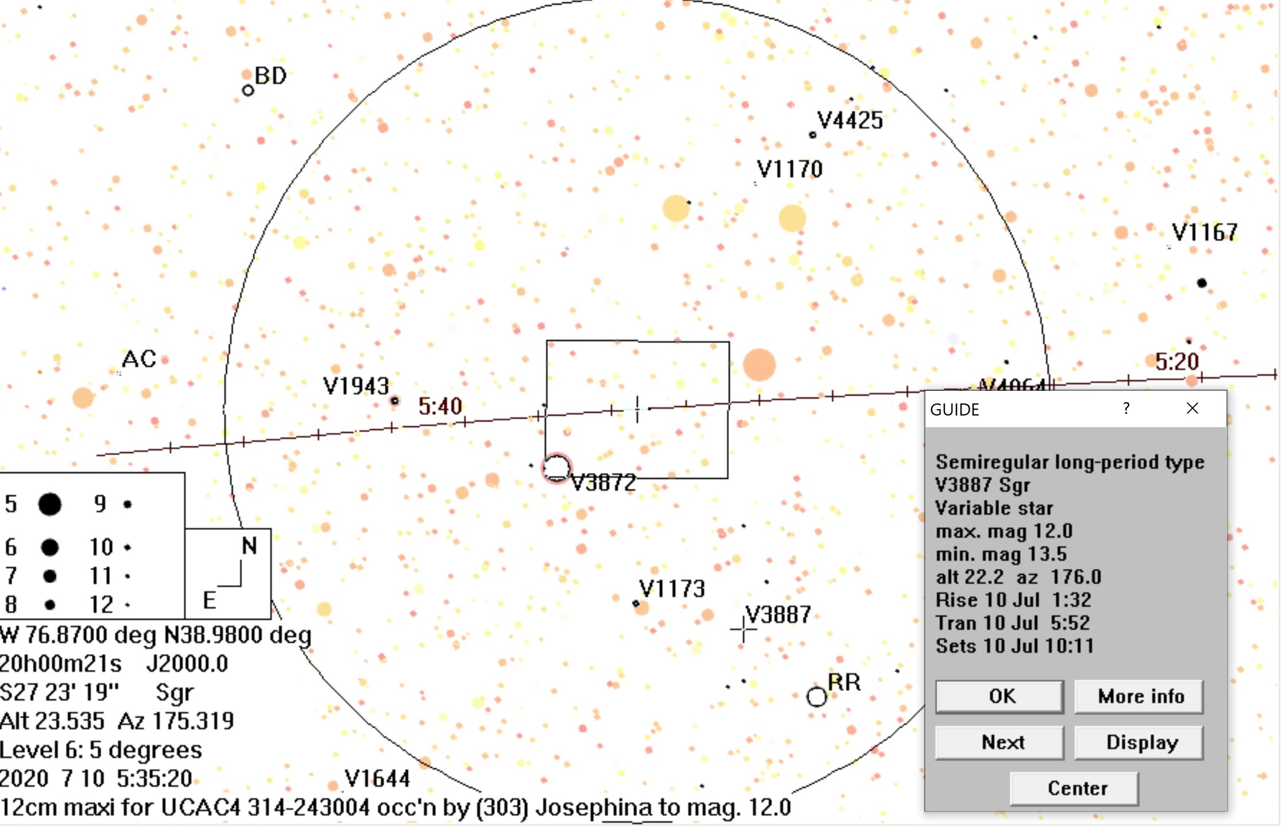
V3887 Sagittarii
The basic info. box below shows that its mag. range is 1.5 and quite faint, so it’s not a concern for us. The “More info” tab shows that it’s Me spectral type.
___

Slide 12
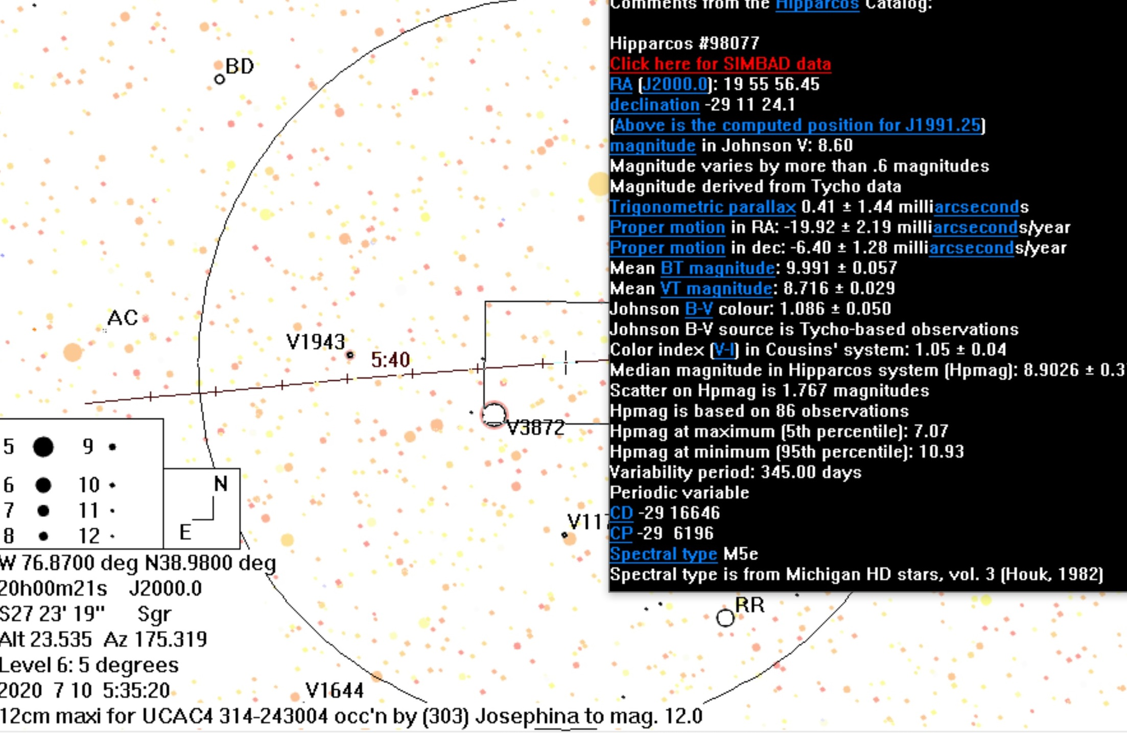
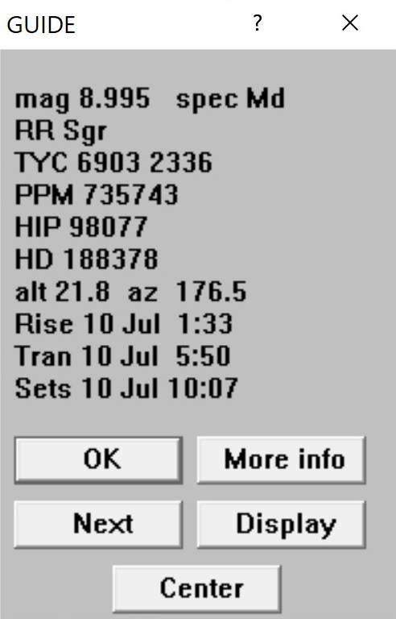
RR Sagittarii
This basic info box doesn’t say what type
of variable variable it is, nor does the “More
info” box to the right (obtained by clicking on
the More info button below) but the star is a
Mira variable according to the link below:
https://www.universeguide.com/star/98077/rrsagittarii
____________________
←Big mag.
range, but
far from pre-point line.
red star, maybe bright, not in my
FOV
__

Slide 13
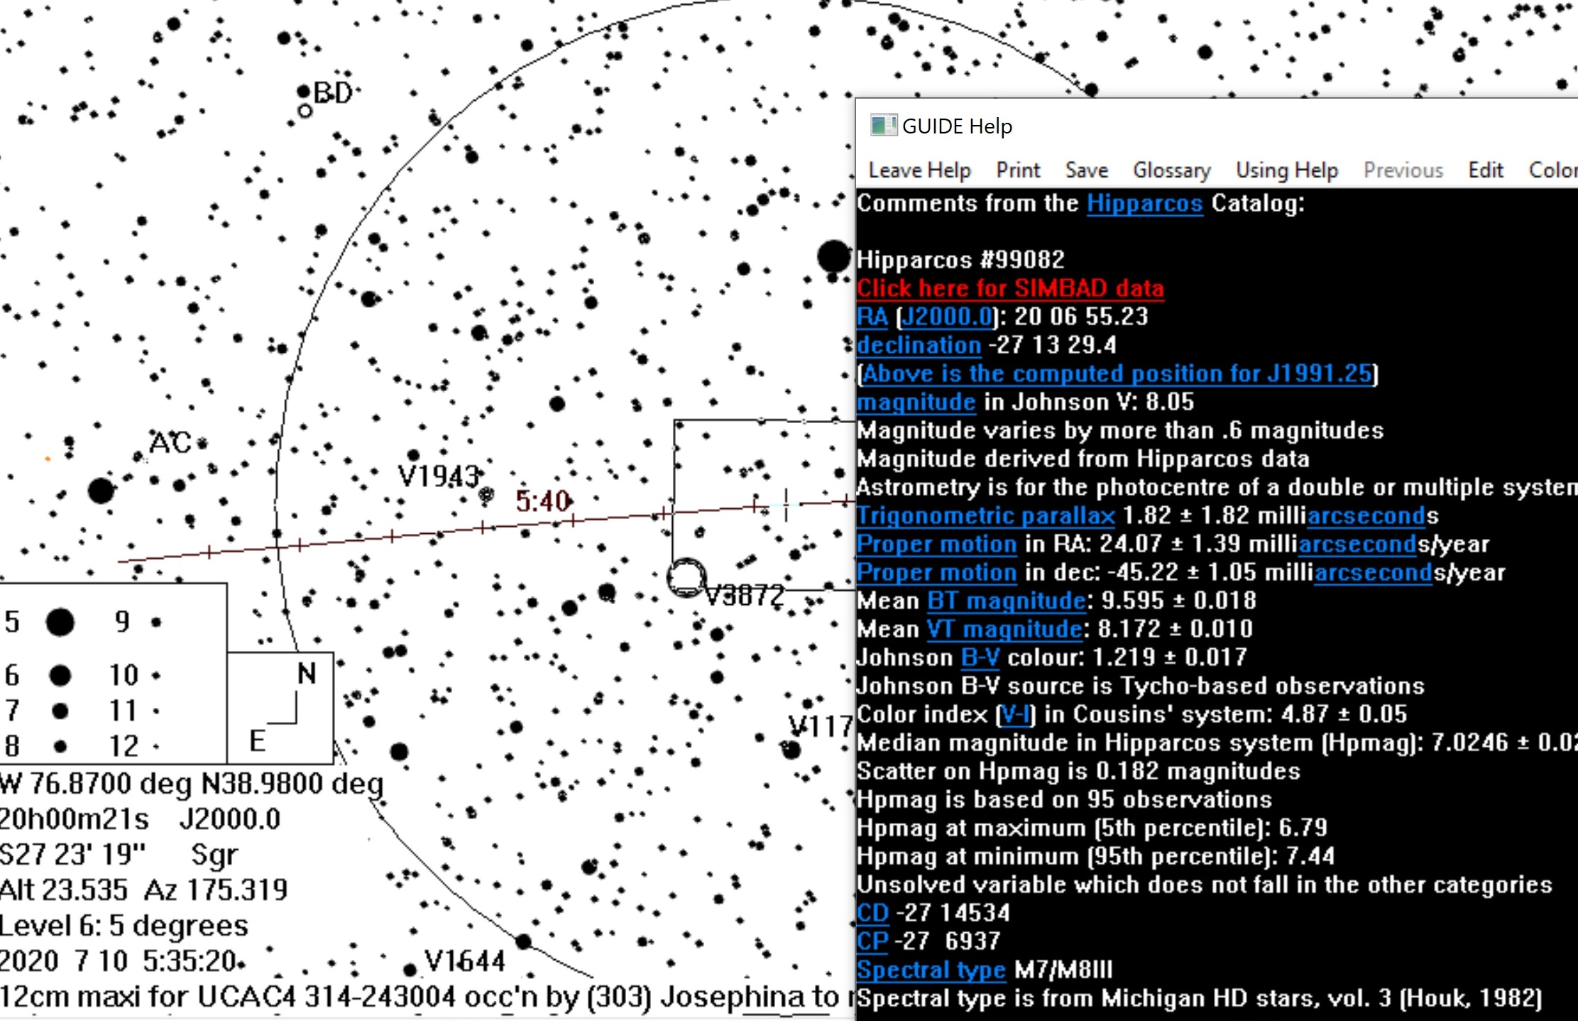
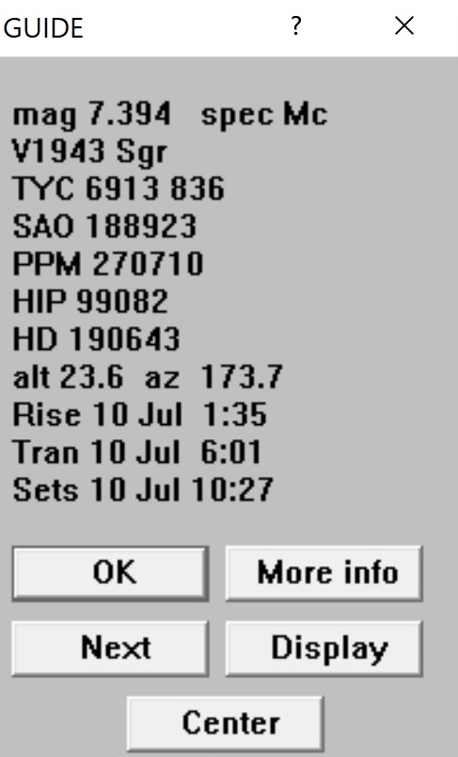
V1943 Sagittarii
The basic info. box doesn’t give the type of variable, but clicking on the “More info” tab (see box to right) shows it’s very red.
It seemed ∼7th visually, but <5 ½ with our
Runcams, <1 mag. fainter than 62 Sgr,
confusing me when I tried to pre-point.
60
___
•
62
←brighter in Runcam
← Very red, bright for us

Slide 14
Conclusions – (Pattern Recognition)
Very red stars, most of which are variable, have deleterious effects on the visual pattern recognition that we rely on for the pre-pointing technique.
It’s important to use a catalog that identifies, and appropriately characterizes (gives possible mag. range), these red stars as they appear in our cameras.
I think this is also useful, or necessary, for automatic pattern recognition for automated systems like those described by Alex Knox.
Talking about Knox’s presentation, I don’t see why that technology couldn’t be used to control larger telescopes, like SwRI’s 16in Skywatchers. Not for remote-station use, but it should certainly facilitate getting on-target (need fewer practice runs) by the observers.
https://www.lpi.usra.edu/sbag/meetings/jan2019/presentations/Tuesday-AM/Buie.pdf

Slide 15
Conclusions (Support for occultations)
At the NASA Small Bodies Assessment Group in January 2019, Marc Buie (SwRI) made a good case for officially supporting occultation work; his presentation is at:
https://www.lpi.usra.edu/sbag/meetings/jan2019/presentations/Tuesday-AM/Buie.pdf
Professional astronomers took notice, with this and the publicity from SwRI’s 2017 and 2018 Arrokoth (MU69) campaigns
White papers for the next astronomical decadal survey are due Aug. 15 (for proposed missions) and Sept. 15 (for others)
I have begun writing one for occultations, saying that small body space missions should allocate a small amount, to support occultation efforts for their projects, similar to what the Lucy project is doing now (they didn’t think of this when they proposed their mission, but are now), and also for public outreach
Marc Buie has said we need to do more than just say “occultations are good”; I think I address that with specific suggestions. He is tied up with preparation for Lucy campaigns this fall (Steve mentioned them yesterday) so he won’t be able to help much before the deadlines. If you want to help with this effort, let me know.

Slide 16
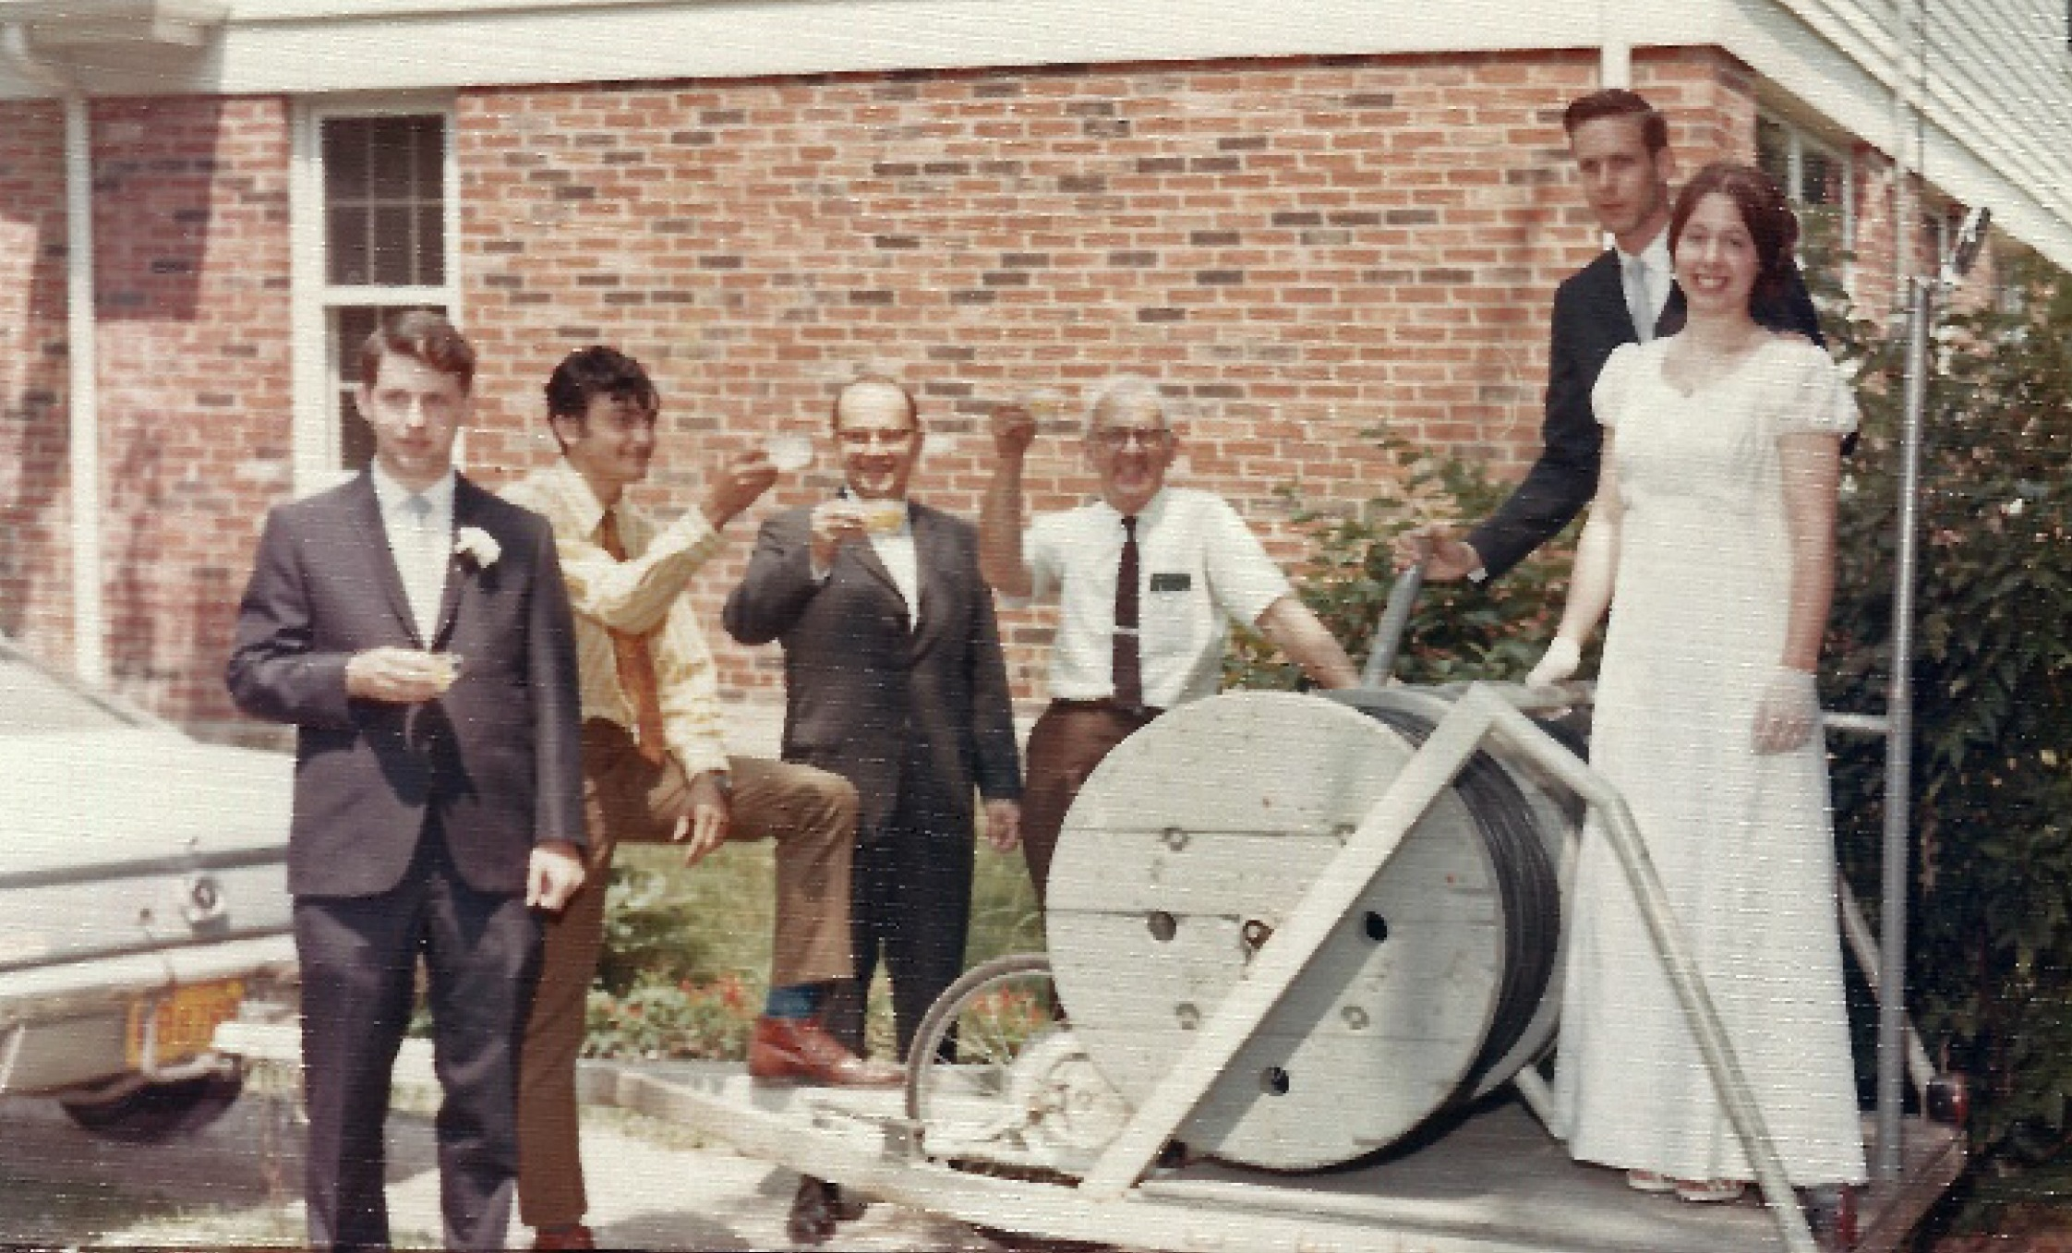
A Day Later, 50th Wedding Anniversary
1970 July 11, Highland Park, IL. Left to right: Tom Van Flandern, Ron Abileah, Homer DaBoll, Ed Halbach, David &
Joan Dunham. If not for COVID-19, we would have had a big family reunion at our home, and then would have
been busy with preparations for that rather than for the Josephina occultation.

